Slide 1
Editors in linux

Slide 2
Linux Text Editors
Linux text editors can be used for editing text files, writing codes, updating user instruction files, and more. A Linux system supports multiple text editors. There are two types of text editors in Linux, which are given below:
Command-line text editors such as Vi, nano, pico, and more.
GUI text editors such as gedit (for Gnome), Kwrite, and more.

Slide 3
The top 20 text editors for Linux:
Vi/VIM editor
Nano editor
Gedit editor
Sublime text editor
VSCode
GNU emacs
Atom editor
Brackets editor
Pico editor
Bluefish
Kate/Kwrite
Notepad ++
Eclipse
gVIM editor
Jed editor
Geany editor
Leaf Pad
Light Table
Medit text editor
CodeLite

Slide 4
Vi/VIM editor
Vim editor is one of the most used and powerful command-line based editor of the Linux system. By default, it is supported by most Linux distros. It has enhanced functionalities of the old Unix Vi editor. It is a user-friendly editor and provides the same environment for all the Linux distros. It is also termed as programmer's editor because most programmers prefer Vi editor.
Vi editor has some special features such as Vi modes and syntax highlighting that makes it powerful than other text editors. Generally, it has two modes:
Command Mode: The command mode allows us to perform actions on files. By default, it starts in command mode. In this mode, all types of words are considered as commands. We can execute commands in this mode.
Insert Mode: The insert mode allows to insert text on files. To switch from command mode to insert mode, press the Esc key to exit from active mode and 'i' key.

Slide 5
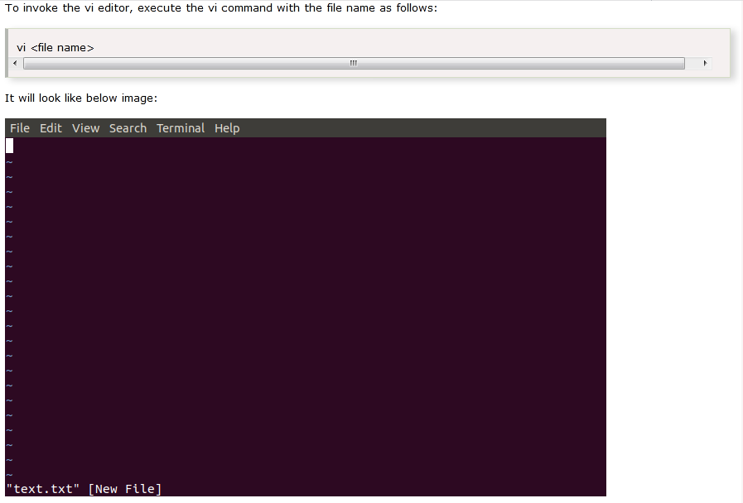

Slide 6
Nano editor
Nano is a straight forward editor. It is designed for both beginners and advanced users. It has many customization features.
Some advanced features of a nano text editor are as following:
It supports syntax highlighting
It has undo and redo options
It provides full line display on the standard output
It has pager support to read from standard input

Slide 7
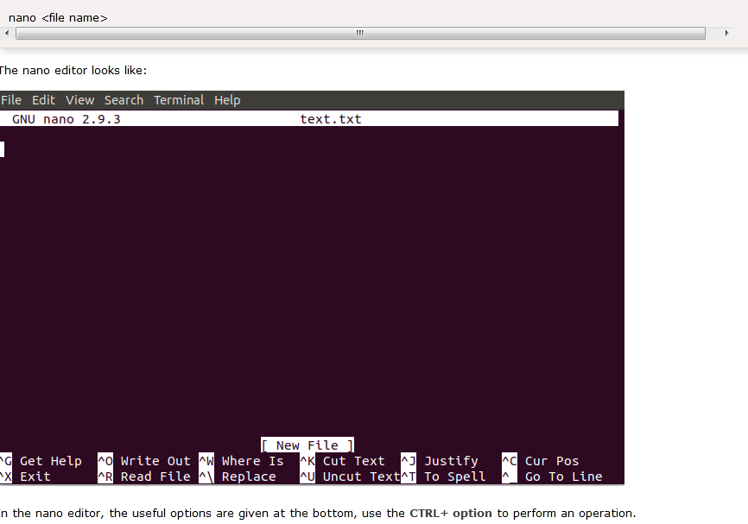

Slide 8
Gedit editor
Gedit editor is the default editor for the GNOME desktop environment. When we open a file, it will open with the Gedit editor. It provides straightforward functionalities like any basic text editor. It is a lightweight editor with a straight forward user interface. It was publicly released in the year 2000 with a GNOME desktop environment. It is developed using the C programming language and supports all font family.
Some key features of the gedit text editor are as following:
It provides syntax highlighting.
It supports internationalized text.
It supports several programming languages.

Slide 9
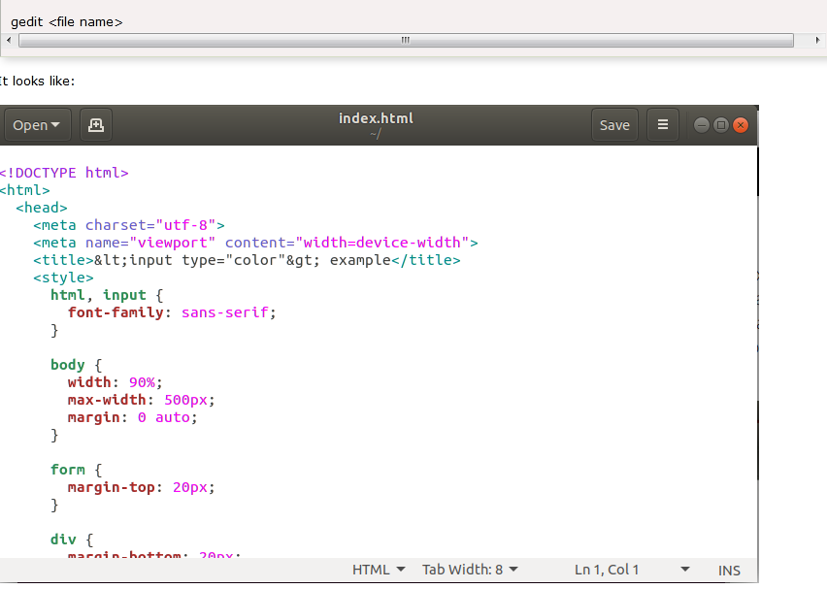

Slide 10
Sublime Text
The sublime text editor is also one of the most popular IDE-based text editors. It is used as a development environment tool more than a text editor. It has several features to support many programming and mark-up languages. Further, it supports numerous plugins to make it more than a text editor.
Some key features of a sublime text editor are as following:
It has an excellent Command Palette.
It is a python-based plugin API.
It supports parallel editing of code.
It provides project-specific preferences.

Slide 11
